Slide 1
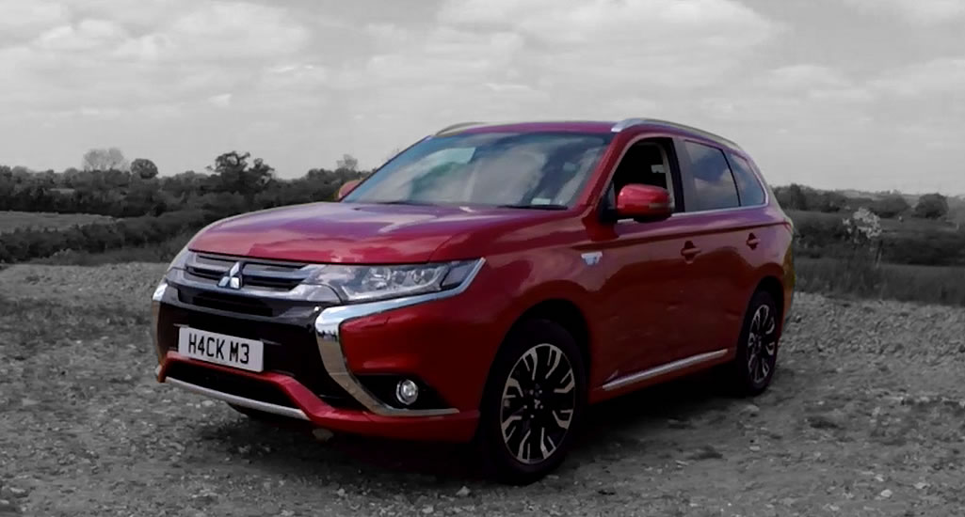
Car Hacking

Slide 2
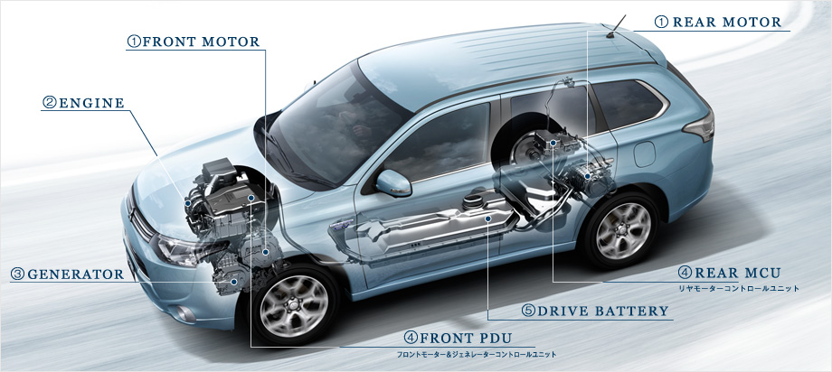
Hybrid technology

Slide 3
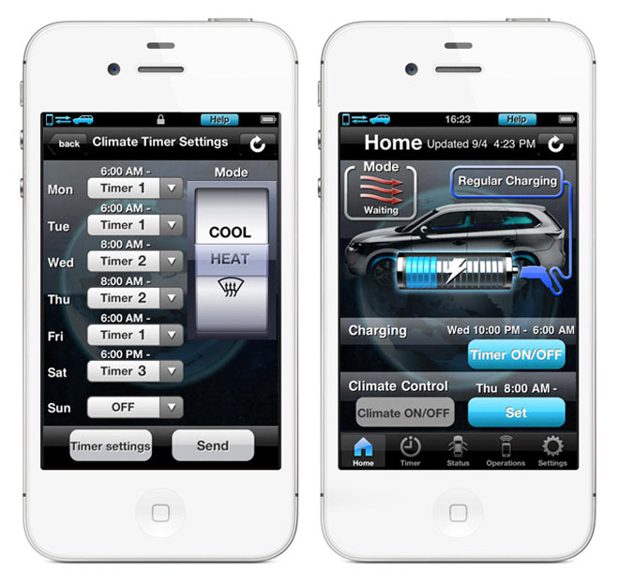
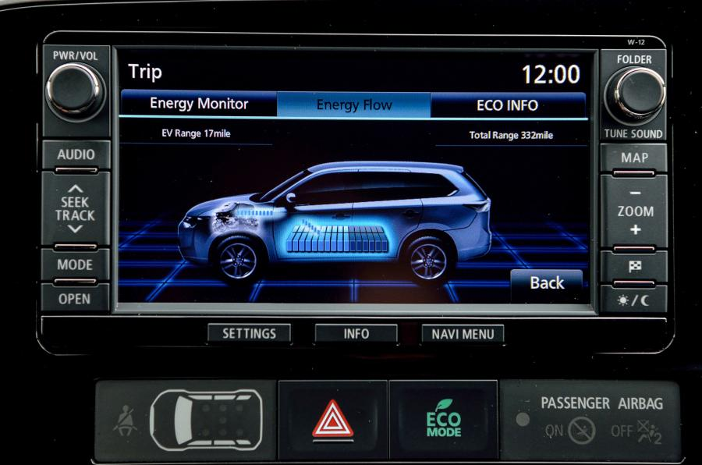
Wi-Fi controls

Slide 4
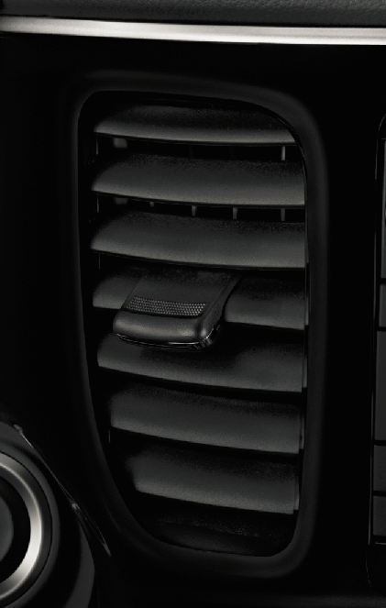

What it does

Slide 5

What’s in the communications?
struct cmd
{
u8 type;
u8 length;
u8 unknown=0;
u8 cmd;
u8 params[];
u8 crc;
}
type=0x6f (a message)
length = 0x10
cmd = 0xc0 (192 or -64)
params = 30 30 31 44 30 31 38 30 30 30 00 01 00 (001D018000)
crc = (6f + 10 + 00 + c0 + 30 + 30 + 31 + 44 + 30 + 31 + 38 + 30 + 30 + 30 + 00 + 01 + 00) / 256 = 0x3e
Parameters will vary in length depending on the length of the packet.

Slide 6
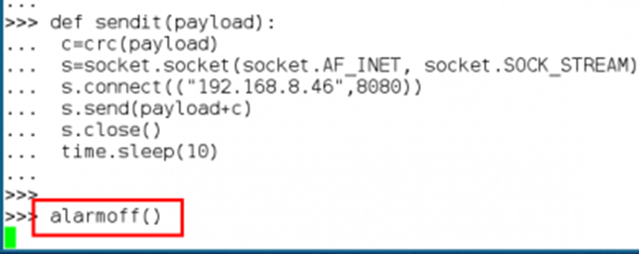
Yep, that happens

Slide 7
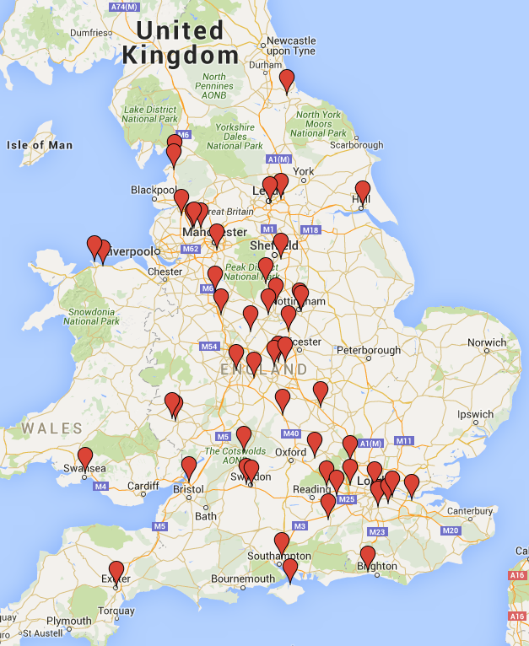
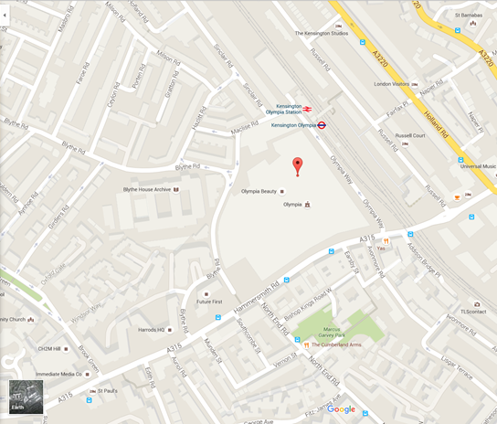
We know where you are

Slide 8


Which is worse?
http://www.thisismoney.co.uk/money/cars/article-3283017/Boris-Johnson-s-video-test-drive-Mitsubishi-Outlander-Hybrid.html

Slide 9
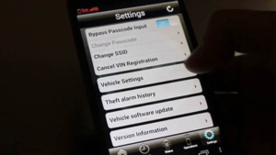
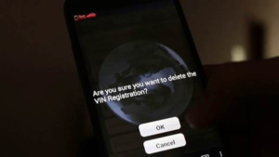
What can you do?

